Slide 1
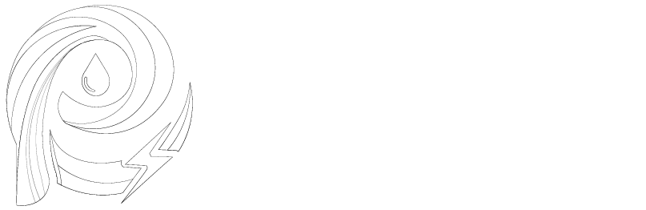
DC Filters: Theory, Design & Practical Implementation

Slide 2

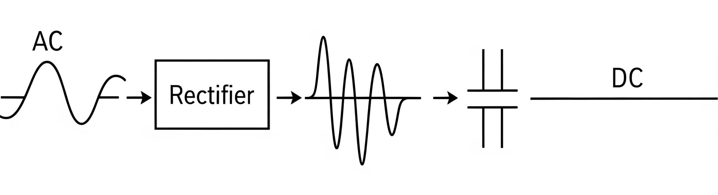
Basics: From AC to DC
- AC → Rectifier → Pulsating DC → Filter → Smooth DC
- The filter’s job: reduce ripple & noise
- Key metrics: ripple voltage, ripple frequency, load current

Slide 3
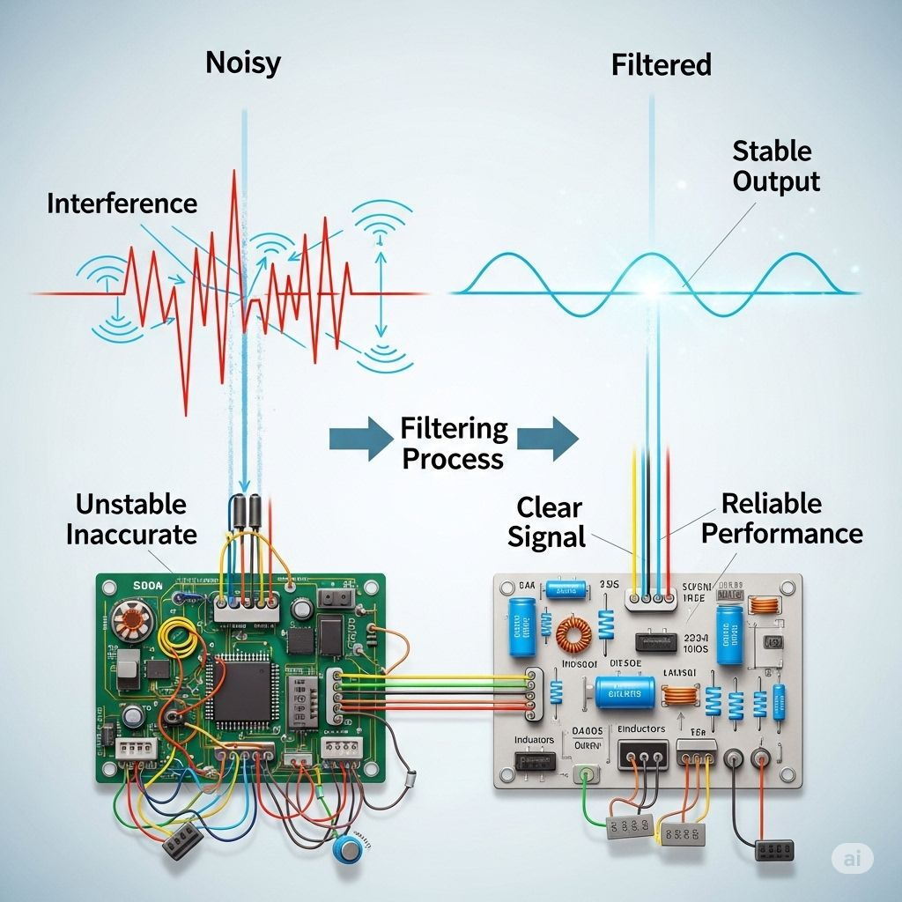
Why Filtering Matters
- Prevents regulator malfunction
- Avoids audible hum/noise in audio
- Prevents overheating & logic errors

Slide 4
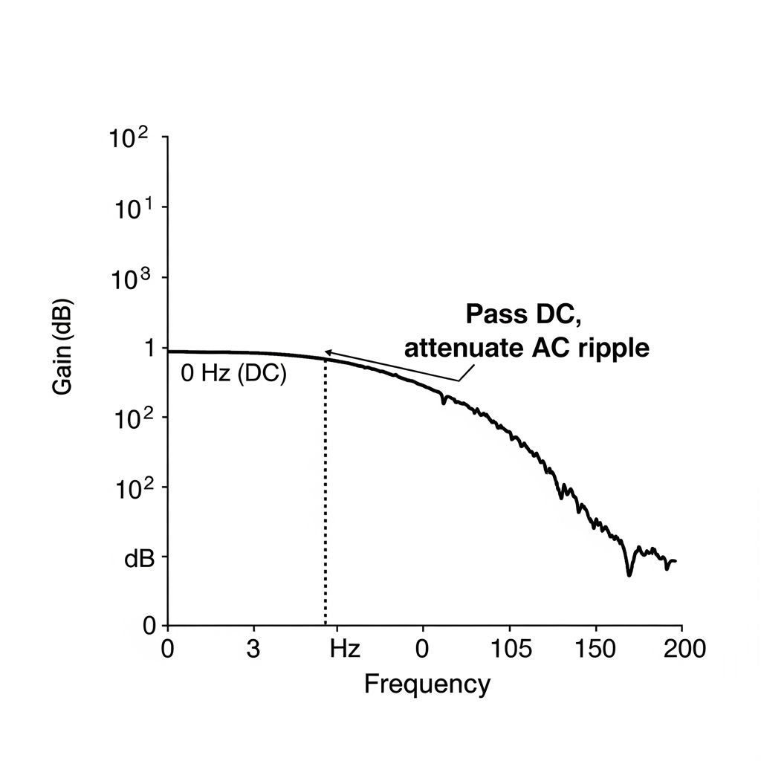
Filter Fundamentals
- Filters = low-pass: pass DC, block AC ripple
- Capacitor stores charge → smooth voltage
- Inductor resists current changes → smooth current
- Cutoff frequency (f_c) is key

Slide 5
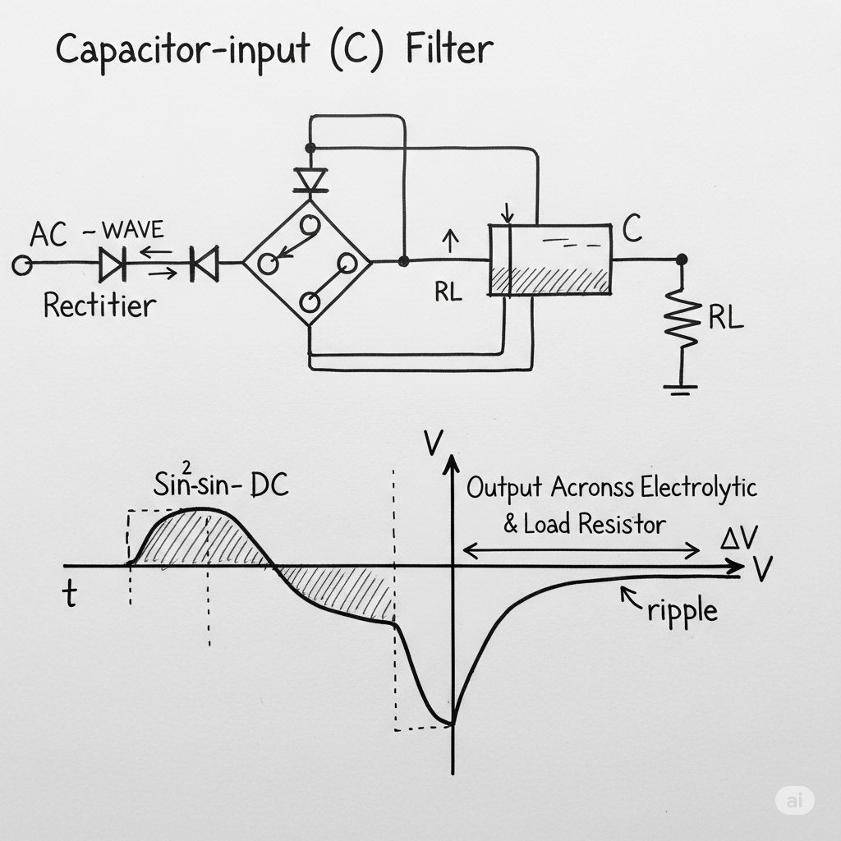
Capacitor-Input (C) Filter
- Large capacitor across load
- Ripple ≈ I_load / (f_ripple × C)
- Pros: simple, cheap
- Cons: high current surges, ESR heating

Slide 6
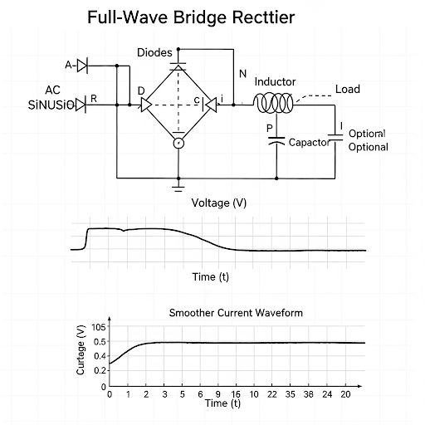
Inductor-Input (L) Filter
- Inductor in series with load
- Smooths current waveform
- Pros: better for high load
- Cons: large, expensive

Slide 7
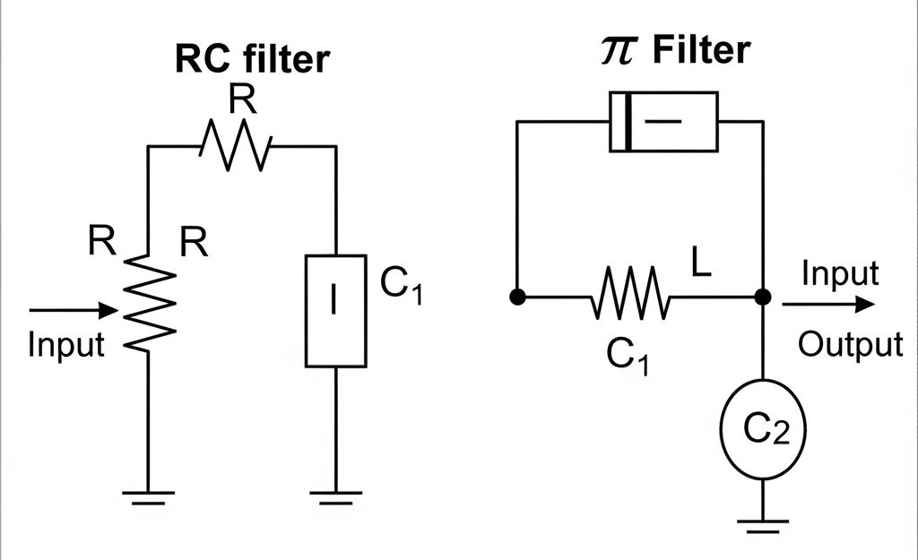
RC & LC (Pi) Filters
- RC: damping for small signals
- LC: strong attenuation, low loss
- Pi (C-L-C): strong ripple suppression

Slide 8
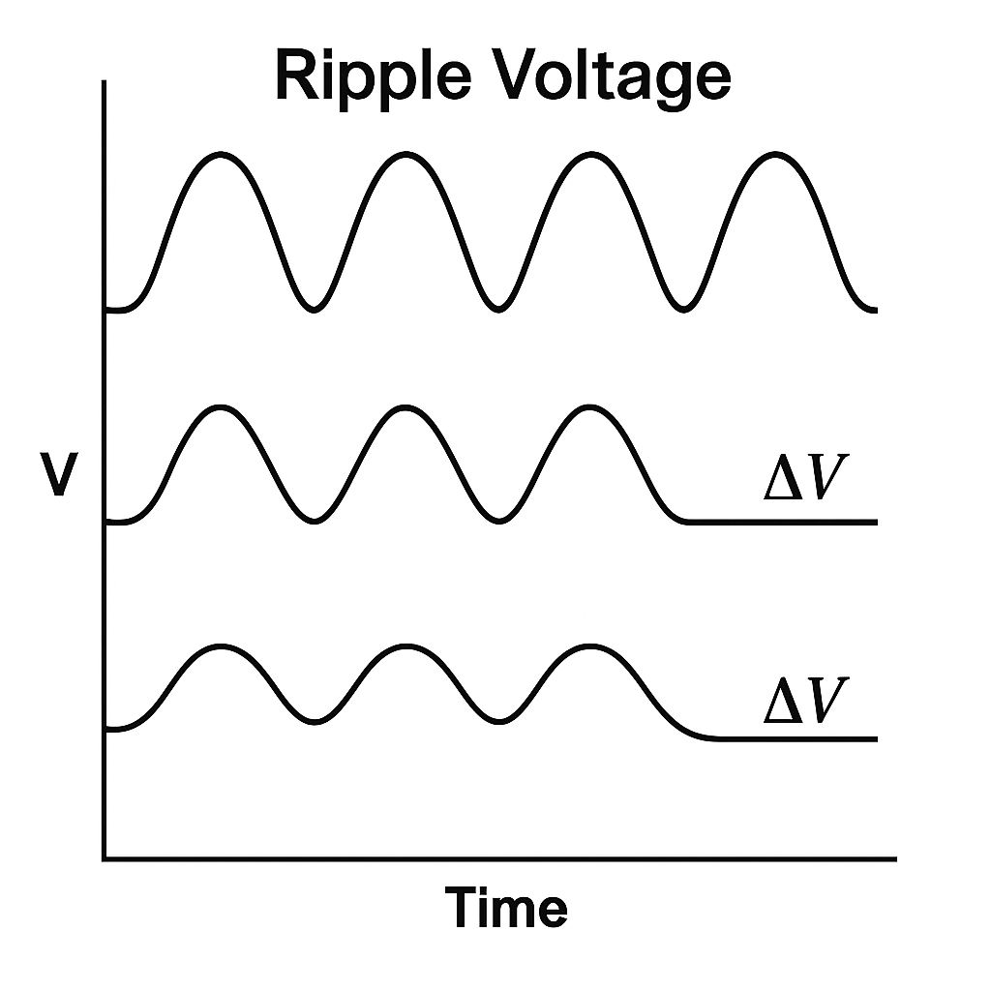
Design Formulas (Capacitor)
- ΔV_pp ≈ I_load / (f_ripple × C)
- C ≈ I_load / (f_ripple × ΔV_pp)
- Units: I_load (A), f_ripple (Hz), ΔV_pp (V)

Slide 9
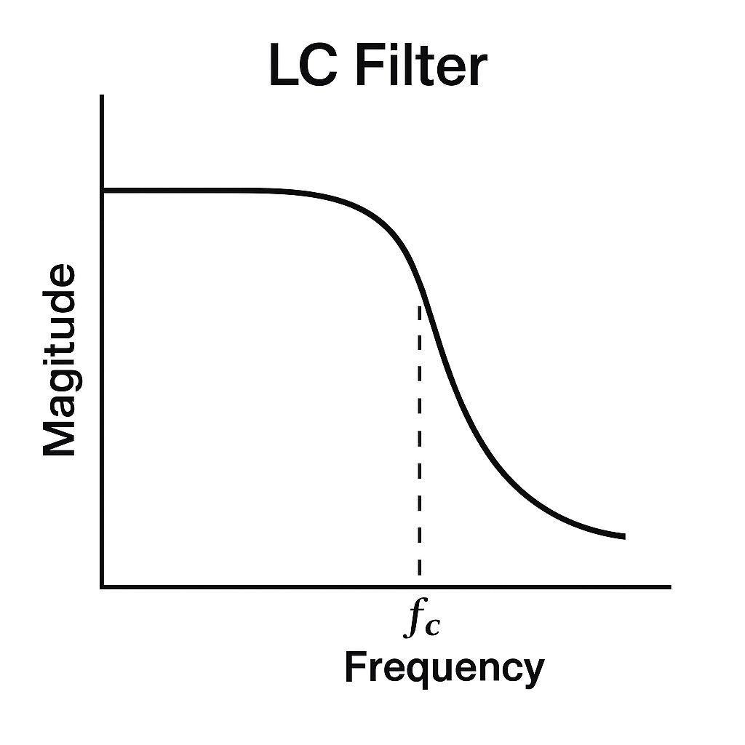
Design Formulas (LC Filter)
- f_c = 1 / (2π√(L × C))
- Pick f_c << ripple frequency
- Add damping to prevent ringing

Slide 10
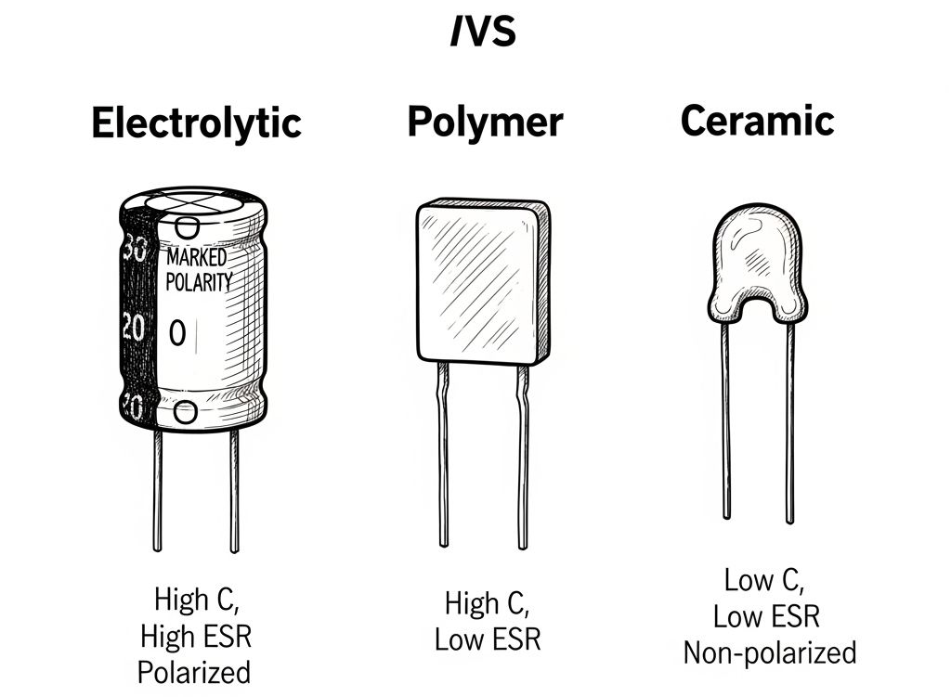
Capacitor Practicalities
- Electrolytic: high C, higher ESR
- Polymer: lower ESR, better performance
- Ceramic: low ESR, lower C
- Check ripple current rating & lifetime

Slide 11
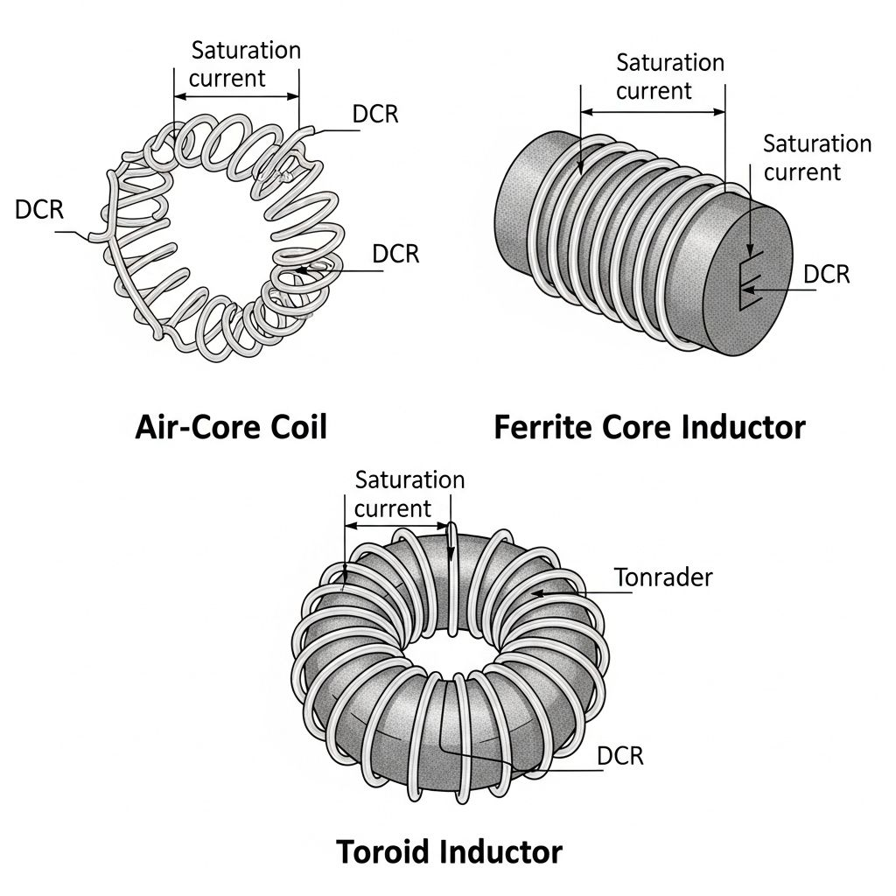
Inductor Practicalities
- Types: air-core, ferrite, toroidal
- Specs: L, DCR, saturation current, thermal rating
- Choose low DCR with margin

Slide 12
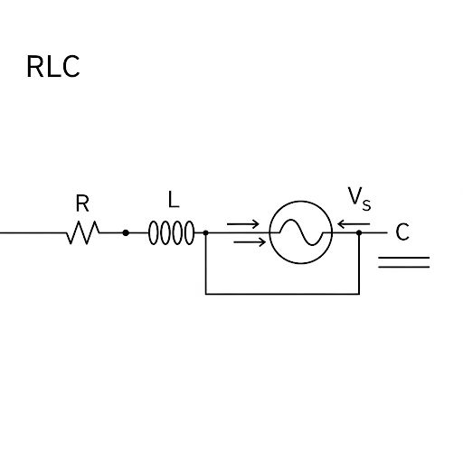
Example: Capacitor Calculation
Given: I_load = 1 A
f_line = 50 Hz → f_ripple = 100 Hz
Desired ΔV_pp = 0.5 V
C = 1 / (100 × 0.5) = 0.02 F = 20,000 µF

Slide 13
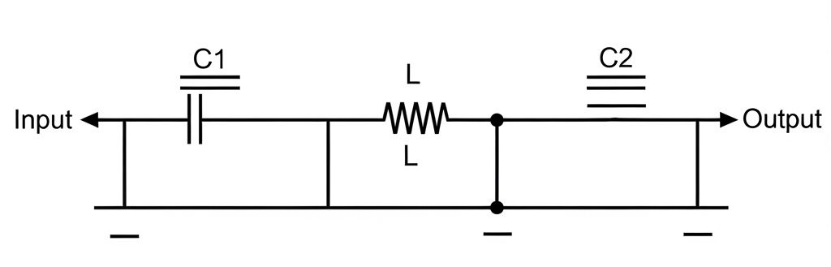
Example: Pi Filter Design
- Goal: Reduce ripple at 100 kHz
- Choose f_c ≈ 10 kHz
- Pick C1, L, C2 accordingly
- Verify via SPICE simulation

Slide 14
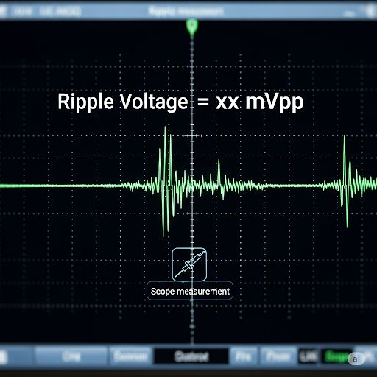
Simulation & Measurement
- Simulate in SPICE
- Measure with oscilloscope
- Metrics: V_ripple, transient response, noise spectrum

Slide 15
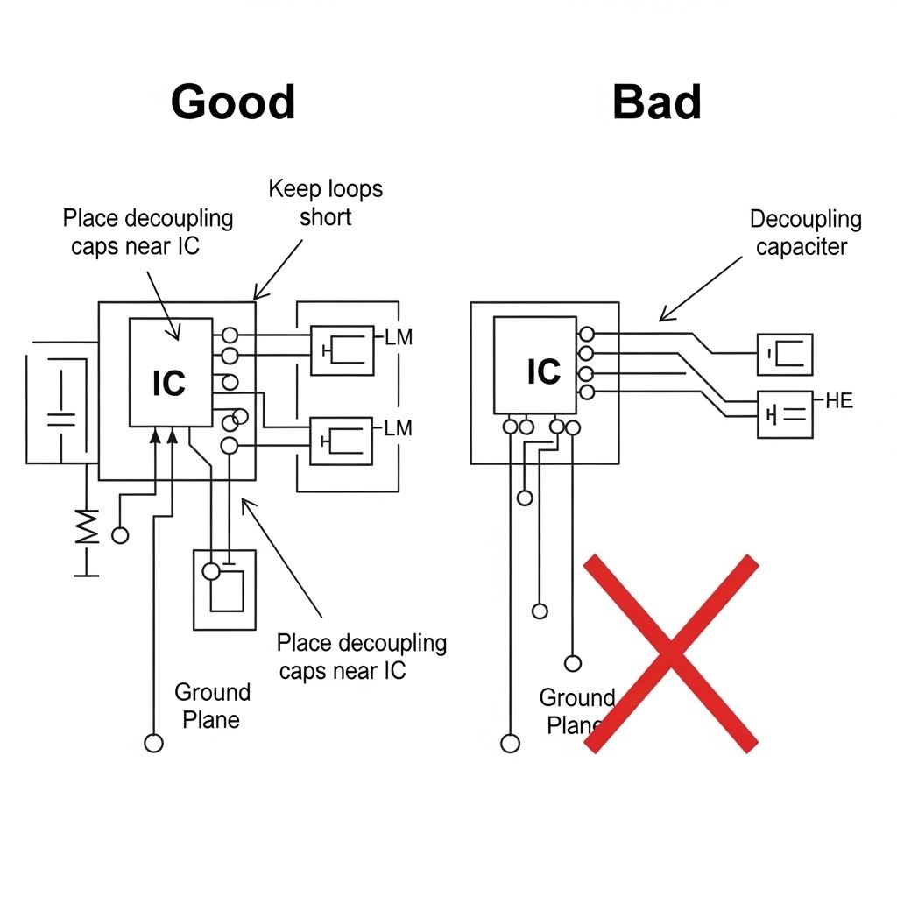
PCB Layout Tips
- Keep loops short
- Place ceramics near ICs
- Use wide traces, multiple vias
- Add snubbers if ringing

Slide 16
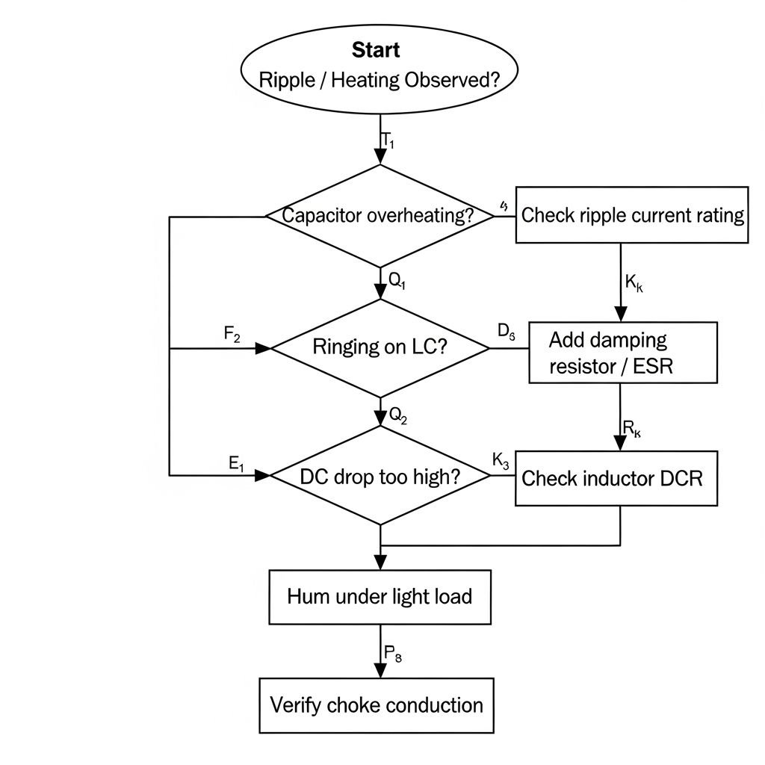
Troubleshooting
- Capacitors overheating → ripple current issue
- Ringing → damping needed
- Unexpected DC drop → check inductor DCR
- Hum → choke conduction problem

Slide 17


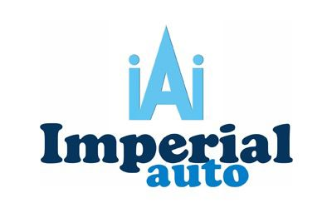
























































Our Clients:

Slide 18




Thank you !
PurityElec Private Limited, 001-002, 1st Floor, C1 Tower, Engineers Enclave, Haldoni Mod, Greater Noida – 201306 (U.P.)
(+91) 8588001002 / 8588002004
support@purityelec.com
sales@purityelec.com
purityelec.com

